Slide 1

PHISHING Awareness Training
#CodeAlpha Internship Task 2
Think before click

Slide 2

What is Phishing?
Phishing is an online scam where fake emails or messages trick you into sharing passwords or personal data.

Slide 3

How it works?
1
Attacker crafts fake
message
3
Victims clicks/
submits data
2
Victim receives &
trusts it
4
Attackers steal information

Slide 4
1
Deceptive Phishing (Bulk Email)
Types of
Phishing
Attacks
2
Spear Phishing
(Whaling)
3
Smishing(SMS Phishing)
4
Business Email Compromise(BEC)

Slide 5

How to spot Phishing Attack?
1
2
3
Check sender
domains
Verify suspicious
links
Watch urgent
threats

Slide 6
Social Engineering Tactics used by Attackers
1
Authority
3
Urgency
2
Reciprocity
4
Fmiliarity

Slide 7
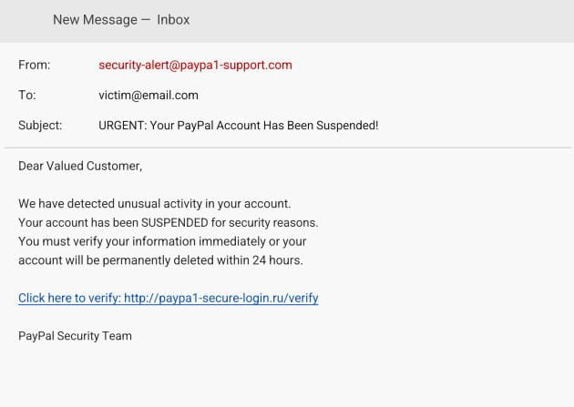
Real-World Example
Anatomy of a Phishing Email
1
Fake Domain
2
Generic Greeting &
No name used
3
Fear & Urgency
“24 Hours” threat
Suspicious URL
.ru foreign domain
4

Slide 8



Basic Security Practices
Don’t share sensitive information
Keep software up to date.
Enable Multi-factor Auth(MFA)
Avoid clicking on suspicious links or attachments.

Slide 9
What to Do If You get phished?
Disconnect Immedietly
Change your password
Enable MFA
Now
1
2
3
Notify IT/
Security Team
Scan your
Device
Report to
Authorities
4
5
6

Slide 10
QUICK QUIZ - TEST YOUR KNOWLEDGE
You receive an email from "security@paypal.com asking you to verify your account. What do you do?
A) Click the link and verify B) Delete it-the domain is fake
C) Reply with your password D) Forward to a friend
Answer: B
1
An attacker targets a CEO with a personalized email using info from Linkedin. This is called?
A) Email Phishing B) Smishing C) Spear Phishing/Whaling D) Clone Phishing
Answer: C
2
Which is the BEST defense against phishing?
A) A strong antivirus only 8) Never use the internet
C) MFA awareness training D) Deleting your email
Answer: C
3

Slide 11

1
Always verify the sender's email address - one typo can mean fraud
Conclusion and Next Steps
2
Never click suspicious links - hover to inspect, or type URLs manually.
3
Enable MFA everywhere - your last line of defense if credentials are stolen.
4
Recognize social engineering: authority, urgency, fear are manipulation tools.
5
Report phishing immediately - protect yourself and your whole organization.

Slide 12

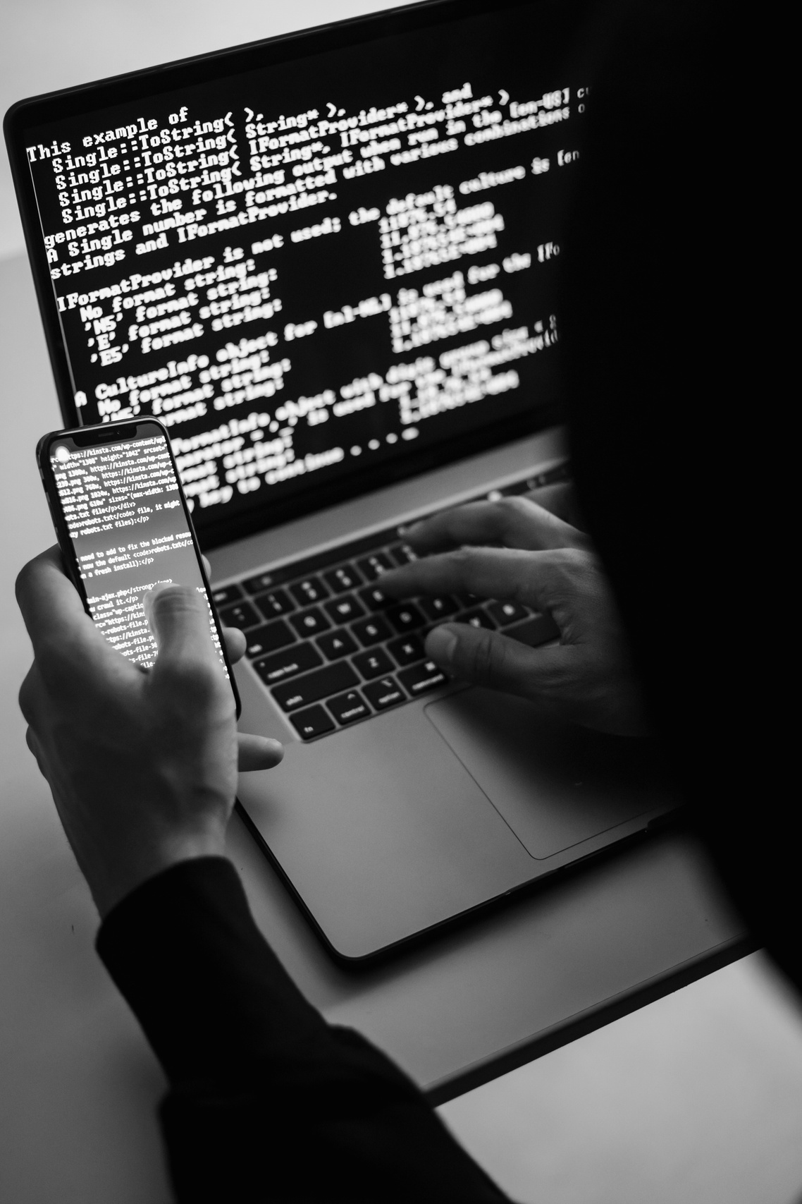
THANK YOU!

